Slide 1
Module 2 Informed Search

Slide 2
Informed (Heuristic) Search Methods
The algorithms have information of the goal state, which helps in more efficient searching.
This information is obtained by something called a heuristic Search.
Informed search algorithm contains an array of knowledge such as how far we are from the goal, path cost, how to reach to goal node, etc.
This knowledge help agents to explore less to the search space and find more efficiently the goal node.
The informed search algorithm is more useful for large search space

Slide 3
Heuristics Function:
Heuristic is a function which is used in Informed Search, and it finds the most promising path.
It takes the current state of the agent as its input and produces the estimation of how close agent is from the goal.
The heuristic method, however, might not always give the best solution, but it guaranteed to find a good solution in reasonable time.
Heuristic function estimates how close a state is to the goal.
It is represented by h(n), and it calculates the cost of an optimal path between the pair of states.
The value of the heuristic function is always positive.
Admissibility of the heuristic function is given as:
h(n) <= h*(n)
Here h(n) is heuristic cost, and h*(n) is the estimated cost

Slide 4
Pure Heuristic Search
simplest form of heuristic search algorithms.
expands nodes based on their heuristic value h(n). It maintains two lists, OPEN and CLOSED list. In the CLOSED list, it places those nodes which have already expanded and in the OPEN list, it places nodes which have yet not been expanded.
On each iteration, each node n with the lowest heuristic value is expanded and generates all its successors and n is placed to the CLOSED list. The algorithm continues unit a goal state is found
In the informed search we will discuss two main algorithms which are given below:
Best First Search Algorithm(Greedy search)
A* Search Algorithm

Slide 5
Best First Search
Greedy best-first search algorithm always selects the path which appears best at that moment.
It is the combination of depth-first search and breadth-first search algorithms.
It uses the heuristic function and search.
Best-first search allows us to take the advantages of both algorithms.
With the help of best-first search, at each step, we can choose the most promising node.
In the best first search algorithm, we expand the node which is closest to the goal node and the closest cost is estimated by heuristic function, i.e.
f(n)= h(n)
Where, h(n)= estimated cost from node n to the goal.
The greedy best first algorithm is implemented by the priority queue

Slide 6
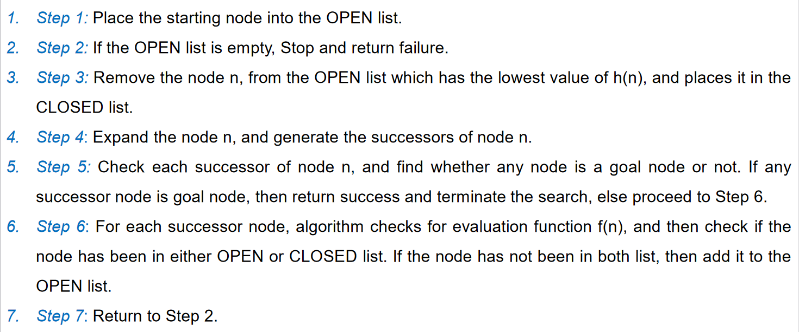
Best First Search Algorithm

Slide 7
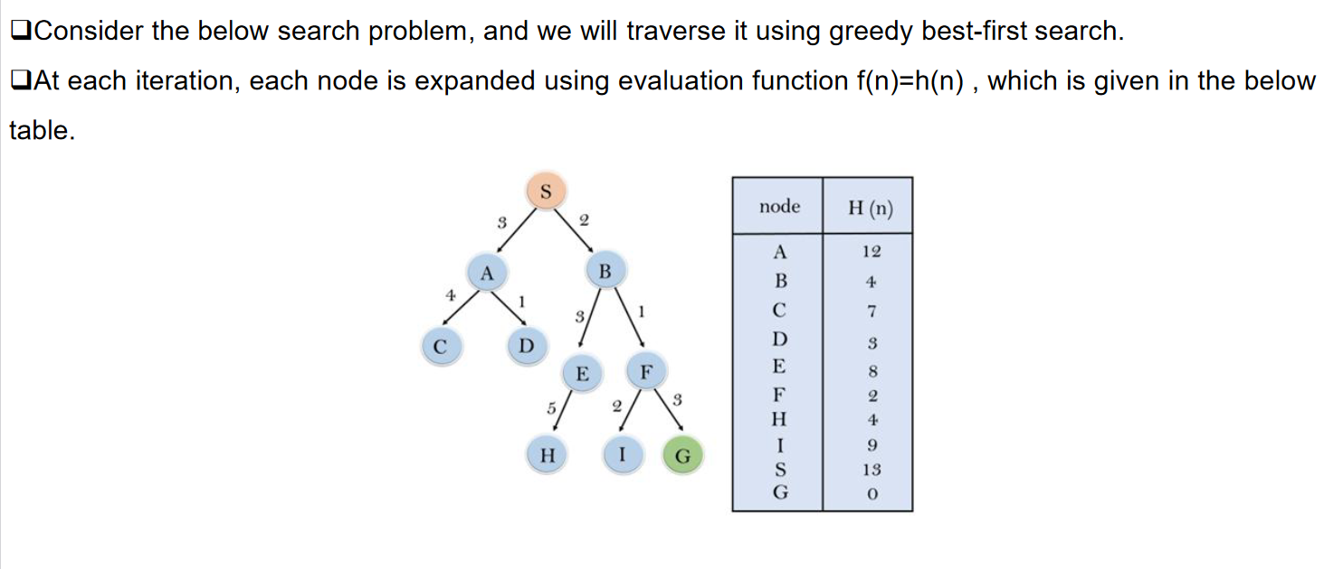
Best First Search Example

Slide 8
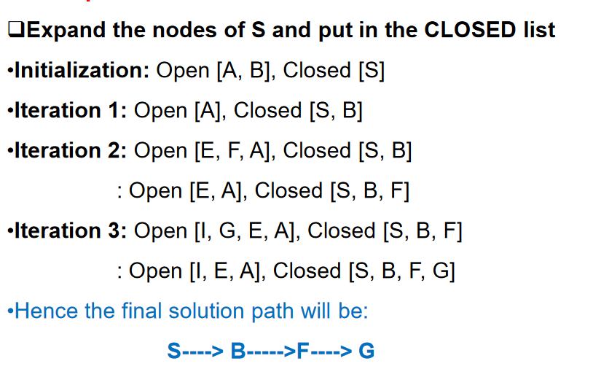

Slide 9
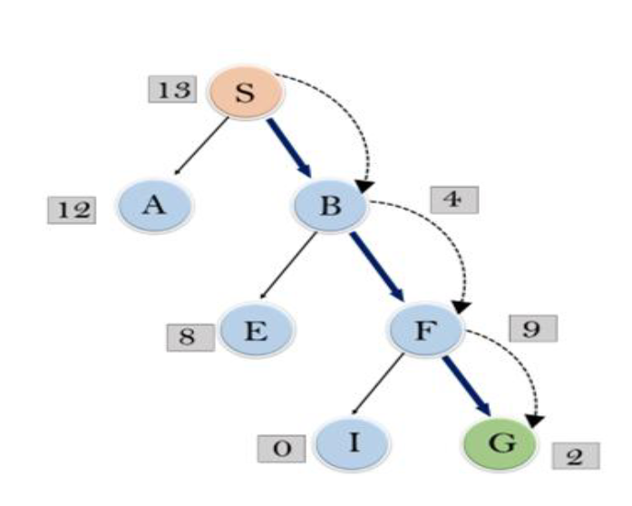

Slide 10
Advantages:
Best first search can switch between BFS and DFS by gaining the advantages of both the algorithms.
This algorithm is more efficient than BFS and DFS algorithms.
Disadvantages:
It can behave as an unguided depth-first search in the worst case scenario.
It can get stuck in a loop as DFS

Slide 11
Performance Measure of Best First Search
Time Complexity: The worst case time complexity of Greedy best first search is O(b^m).
Space Complexity: The worst case space complexity of Greedy best first search is O(b^m). Where, m is the maximum depth of the search space.
Complete: Greedy best-first search is also incomplete, even if the given state space is finite.
Optimal: Greedy best first search algorithm is not optimal

